Slide 1
An Action Plan: Addressing Mental Health and Substance Abuse Needs for the Deaf and Hard of Hearing
Notes:
Introduce each presenter and credentials.

Slide 2
How Successful Would You Be If….
You took an I.Q. test in Chinese?
You could only speak French and your Spanish-speaking family could only use rudimentary French at best?
You had to explain a traumatic event to a counselor in Russian?
Notes:
Eve
Ask these questions to start the Task Force members thinking from the perspective on what Deaf and HoH people encounter daily.
Today we will be talking about an underserved population in the field of Mental Health. We know that this is just ONE of many minority groups but hearing loss touches across all cultures and ethnicities and is the largest disability group. NAD estimates approximately 28 MILLION people in the U.S. who are Deaf or Hard of Hearing.

Slide 3
It’s A Matter of Communication
Family
School
Friends
Work
Media
Notes:
Eve
Communication: It's a matter of the language that is available to the person trying to express his/her feelings. It's also a matter of the language available to the person receiving the information. Without that a real breakdown in communication can occur, only adding more frustration to a person who is already frustrated.
Family – it is estimated that approximately 90% of children who are Deaf are born into hearing families. Of that 90%, it is estimated that approximately 2% of the parents learn sign language well enough to communicate effectively with their Deaf child. Often one member of the family takes on the role of “family interpreter” (usually the mother or a sibling) and serves as the link between the Deaf child and the other members of the family. One study found that deaf boys were three times more likely and deaf girls twice as likely to report sexual abuse, compared to children who could hear.
Researchers found that deaf children who cannot make themselves understood within their family are four times more likely to have mental health disorders and more likely to suffer mistreatment at school than deaf children who can communicate with their family members
School – teachers (if they sign) and school interpreters are often not Native Language users.
Friends – it’s a hearing world. Deaf children often do not live very close together and neighborhood friends will often be hearing.
Work – most bosses and coworkers will be hearing. Can be left out of crucial information on how to improve job performance, opportunities for advancement, even socialization opportunities – gossiping around the water cooler.
Media – many YouTube videos are not captioned, if they are – the captions are not accurate. Talk about Netflix, newscasts, emergency broadcasts.

Slide 4

One Size Does Not Fit All
Notes:
Eve
No hearing loss is the same:
Mild
Moderate
Severe
Profound
Degree of Sound Discrimination
Method of Communication
Oral
Signed English
Total Communication
PSE
ASL
Home Signs
None
Types of aids – bilateral or only in one ear
Hearing aids (behind the ear, in the ear, implantable models, bone conducting)
Cochlear Implants – how soon and how successful
Use of other Assistive Listening Devices

Slide 5
Swiss Cheese Anyone?
Incidental
Learning
Vulnerable Targets for Abuse
Social
Isolation
Culture
Language
High
Unemployment
Notes:
EVE
Visual Guide to barriers people who are Deaf face when interfacing with Mental Health Services across the country. These are just the top examples of the dichotomy of a Deaf person in a hearing world.
Give a brief explanation on each one as they spiral in (must click to start each animation).
1 – Culture
2 – Language
3 – Social Isolation
4 – Vulnerable Targets for Abuse
5 – Incidental Learning
6 – High Unemployment

Slide 6
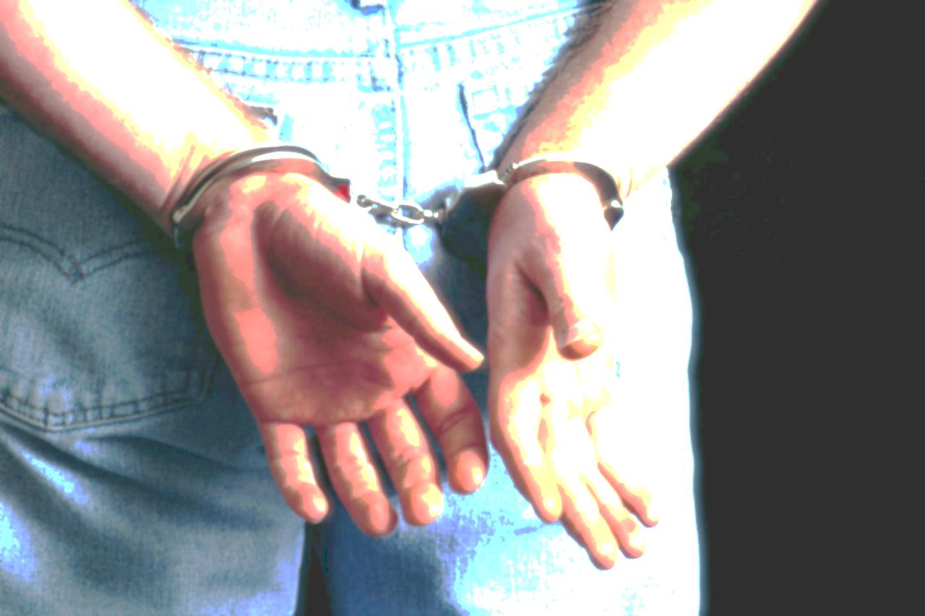
What Happens?
Higher Rates
  Victims becoming Offenders
  Alcohol & Drug Abuse
  Recurring Relapses
  Suicides
Higher Costs
  Longer Inpatient Hospitalizations
  Interactions with Law Enforcement
  Incarcerations
  Failure to Thrive
Notes:
EVE
Tell story of Deaf man seeking help for depression who ended up labeled as a risk to himself and others by the admitting nurse who interviewed without an interpreter. The man’s frustration mounted as his repeated requests for an interpreter were misunderstood by the admitting nurse, thus his requests were ignored. He was held without access to interpreting services for six weeks. Once an interpreter was provided, he was released within three hours. He left the facility and did not seek further assistance. This not only impacts him, but other people in the Deaf community who will not seek help for fear that this may happen to them!
Highlight the significance of the picture in the background. Handcuffs is perceived in the Deaf Community like tape over the mouth.

Slide 7
What does Equal Access look like?
Notes:
EVE
Not just a single “signing” counselor.
Talk about the limitations of just using interpreters
Don’t have the knowledge or perspective of the professional
They are not substitute for genuine understanding of Deaf culture, the Deaf experience
May not always be a match for the patient’s language
Small Deaf Community – patient may experience discomfort with using interpreter they see in personal or work life.
Reduces liability for misdiagnosis
Allows the services to be focused on the mental health issues of the patient instead of the attending to the communication barriers.
Reduced ER visits
Repeated hospitalizations reduced
“Chronic” clients can be seen short-term & in less restrictive settings

Slide 8

An Anecdotal Experience
Notes:
Denise
To highlight a personal experience with how Deaf and Hard of Hearing people do not get the messages created by hearing systems, Denise will share her personal story about the egg commercial.
Here is my story: I remember a commercial I saw when I was a teenager that could have provided valuable information, but whose message I missed because it was not captioned. In the commercial, a woman was talking and cooking fried eggs. I assumed that this woman was trying to sell eggs. I thought the eggs looked good and it made me hungry (again remember I did not have the closed-caption decoder box and I cannot hear). However, many years later I realized that this commercial was not about selling eggs. In fact, this commercial was trying to educate the community that these frying eggs are like cooking your brain when you are using drugs. I was very upset about the missed valuable lesson that I could have learned. If I had understood the commercial, I could have asked my parents for more information about what drugs are. I ended up using drugs in college for a few years.

Slide 9

Mental Health Steering Committee:
Who are we?
Notes:
Denise
Working together to pull the current state of affairs back from the edge of the cliff.
Members include reps from:
ODHH
Mental Health America of Wisconsin
IndependenceFirst
Wisconsin Coalition of Independent Living Centers, Inc.
DHS Division of Mental Health & Substance Abuse Services
UW Hospitals & Clinics
Deaf Unity
WESP-DHH
WAD
Community Representatives
Family Members
Sign Language Interpreters

Slide 10

Our Vision
People of all ages who are deaf, deaf blind or hard of hearing receive needed mental health and substance abuse services that result in recovery and optimal individual quality of life.
Notes:
Denise
We are collectively looking to turn the page on the current situation. It is our vision that People of all ages who are deaf, deaf blind or hard of hearing receive needed mental health and substance abuse services that result in recovery and optimal individual quality of life.

Slide 11
Our Objective
Develop a strategic plan defining state-level goals that lead to sustained, aligned and collaborative cross-system partnerships, leadership and action among people who are deaf, deaf-blind and hard of hearing and multiple partners in the mental health and alcohol and substance abuse systems.
Notes:
Denise
In keeping with this objective, we convened a very successful summit in March of this year during which over 80 people discussed their growing awareness regarding the state of affairs in Wisconsin’s mental health system, developed priorities for implementation and discussed possible collaborations.

Slide 12
Action Plan
Developing Useful Information Resources
Addressing Licensing Issues
Expanding Utilization of Tele-Health
Seeking Financial Resources for Support
Representation Opportunities on Key Boards, Councils & Committees
Use of Technology to Increase Collaborative Partnership
Notes:
Denise
We have identified priorities as a result of the outcome of the summit and determined the top six to begin to address. The workgroups will develop an implementation work plan in each area.
** Give brief intro to each workgroup and what they are exploring. Emphasize there is a lot of area for cross-workgroup collaboration.

Slide 13

Developing Information Resources
Trainings & Tool Kits for Professionals and related staff
Educating Deaf, Hard of Hearing & Deaf-Blind Communities
  What is mental health
  Resources available to those in need
Notes:
Denise

Slide 14
Addressing Licensing Issues
Barriers to Direct Service Providers
  Inter-State Reciprocity
  Supervised Hours
  Accommodations During Testing
  Challenges to Employment
  Telehealth Options
  Interpreters
Notes:
Denise

Slide 15
Expanding Utilization of Tele-Health
Licensing
Liability & Procedure Guidelines
Infrastructure
  Locations & Equipment
  Providers
Education
  Professionals
  Deaf, Deaf-Blind & Hard of Hearing Communitees
Notes:
Melani
Briefly explain what telehealth is and what it looks like. Can work well for those people who already use Video Phone for their communication.
Goal is to establish a telehealth pilot program.

Slide 16
Seeking Financial Resources for Support
Identify
  Resource Needs
    Short Term
    Long Term
  Funding Sources
  Key Partners
Develop Needs Assessment Document
Notes:
Melani

Slide 17

Representation Opportunities on Key Boards, Councils & Committees
Identify
  Boards,Councils, Taskforces, etc.
    Application Process
  Key Representatives
Match
Provide Support
Notes:
Melani
Touch on the fact that some education and training may be necessary to get boards acquainted with how to work with and accommodate persons who are Deaf, Hard of Hearing or Deaf Blind.

Slide 18
Use of Technology to Increase Collaborative Partnership
Website
  Resources
  Updates & Announcements
  Connecting with Committee
ListServe
Notes:
Melani

Slide 19
The Georgia Judgment
Belton v. Georgia (March 30, 2012)
Plaintiffs assert Georgia Violated the ADA in four respects
  Lack of ASL-fluent mental health practitioners
  Failure to reimburse medical providers for interpreting services
  Failure to provide deaf-appropriate group home care settings
  Refusal to provide adequate funding for deaf services
Notes:
Melani
This is the LATEST news in the field of mental health and deafness!!
Important to mention that this judgment has been handed down and is now assigned to a magistrate judge for mediation to determine the appropriate remedy.

Slide 20
The Current State of Accessible Mental Health Services in Wisconsin
=
Notes:
Melani
Wisconsin has the same DEARTH of linguistically and culturally competent services available to people who are Deaf, Hard of Hearing or Deaf-Blind.

Slide 21
South Carolina
Before State Program
After State Program
11 People
260 People
Notes:
Melani
Case Example:
South Carolina
Before change: spent $1.4 million on 11 “chronically” mentally ill deaf patients in the in-patient program
After change: approximately same $ services 260 patients on an outpatient basis in their communities.
No need for in-patient program!
While Minnesota and Alabama’s state-wide programs were established as the result of a lawsuit, South Carolina’s program was started in response to a complaint with the US Department of Justice. It is funded by a combination of funding streams including Block Grant funds, Medicaid and third party revenue, other client income and State appropriations.

Slide 22
How Can You Contribute?
Information
Contacts
Sources of Funding
Partners
Guidance
Questions?
Notes:
Melani
In conclusion, we know it is a big mountain to tackle, but as in this picture – we believe that together, we can create a fertile ground, growing a healthy system that would allow those who are Deaf, Deaf-Blind or Hard of Hearing who need Mental Health services will ultimately be able to soar.

