Slide 1
2013 Budget Listening Sessions
2013 Budget
Listening
Sessions
August 13 & 14
Chris Abele
Milwaukee County
Executive

Slide 2
Agenda
2013 Budget
Listening
Sessions
August 13 & 14
County Overview
County Budget Overview
Fiscal Challenges
2013 Budget Strategy
2013 Budget Calendar

Slide 3
County Overview
2013 Budget
Listening
Sessions
August 13 & 14
Mandated Services*
Behavioral Health | Law Enforcement
Veterans’ Services | Circuit Courts
Child Support Enforcement | Criminal Prosecution
Juvenile Justice | Highway Safety Commission
Developmental Disabilities Services | BadgerCare
Section Eight Housing & HOME Programs | Juvenile Placement
* Examples of Major Programs Listed, Not All-Inclusive

Slide 4
County Overview
2013 Budget
Listening
Sessions
August 13 & 14
Discretionary Services*
Parks & Park Security | Transit
Cultural Institutions | UW-Extension
Aging | Zoo
Alcohol & Drug Treatment | County Trunk Highways
Economic Development | Nursing Homes
Interim Disability Assistance Program | EMS Support
Supportive Housing | Rehab Centers
* Examples of Major Programs Listed, Not All-Inclusive

Slide 5
The County Budget
2013 Budget
Listening
Sessions
August 13 & 14
2012 Revenues by Source

Slide 6
The County Budget
2013 Budget
Listening
Sessions
August 13 & 14
2012 Tax Levy by Major Function

Slide 7
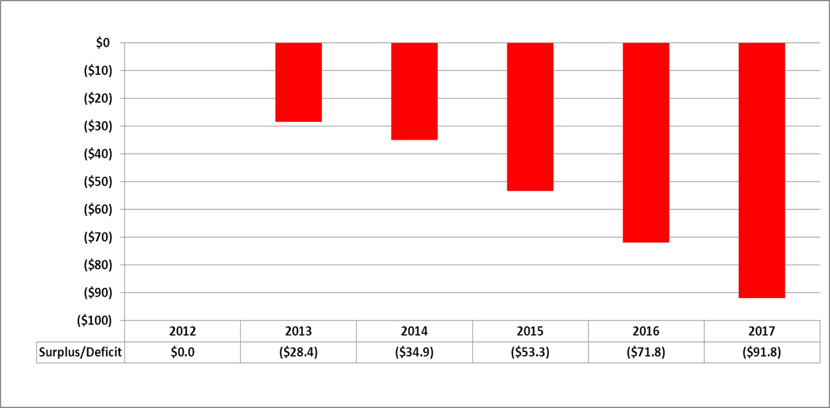
Fiscal Challenges
2013 Budget
Listening
Sessions
August 13 & 14
The County’s Structural Deficit
Projected Structural Deficit – 2012 Adopted County Budget (in millions)
Source: Milwaukee County 5-Year Fiscal Projection (Municast)

Slide 8
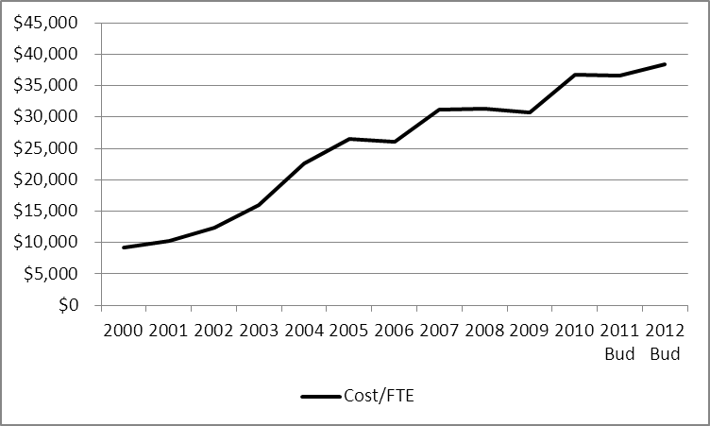
Fiscal Challenges
2013 Budget
Listening
Sessions
August 13 & 14
Health, Pension/Etc. Trends
Total Active & Retiree Fringe Benefit Costs per Budgeted FTE, 2000-2012

Slide 9
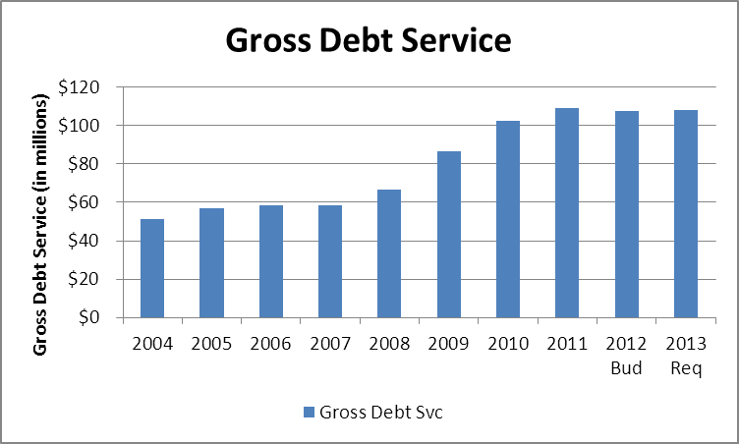
Fiscal Challenges
2013 Budget
Listening
Sessions
August 13 & 14
Debt Service

Slide 10
2013 Budget Strategy
2013 Budget
Listening
Sessions
August 13 & 14
Guiding Principles:
Long-term Sustainable Service Delivery
Data-based Decision-making
Is it Mandated?
Is it a Priority?
Should Property Tax Payers Fund This?
Do Others Provide this Service More Efficiently?
Do Citizens Rely on the County to do This?
Are there Best Practices We Can Adopt?

Slide 11
2013 Budget Strategy
2013 Budget
Listening
Sessions
August 13 & 14
Key Focus Areas:
Programs for Those Most in Need
Efficiency
Long-Term Cost Reduction & Avoidance
Sustainable Budgeting
Shared Services
Non-Mandated Programs

Slide 12
2013 Budget Calendar
2013 Budget
Listening
Sessions
August 13 & 14
Key Dates:
September 27: Recommended Budget Presentation
October 8 – October 31: County Board Finance & Audit Committee Budget Hearings
October 29: County Board Public Hearing
November 5: County Board Budget Adoption Day

